Slide 1
Signal Integrity Training
INSTRUCTION: Cover image below may be replaced in the slide master with another image from either the Images PowerPoint provided in the same download location as this template OR a licensed image which meets TE’s photography guidelines to meet user’s requirement. Delete this instruction in final presentation.
Justin Pickel 8/2022

Slide 2
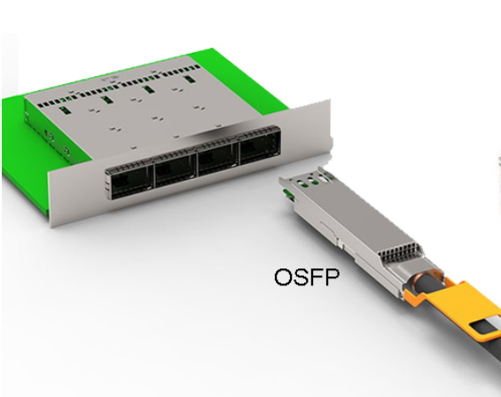
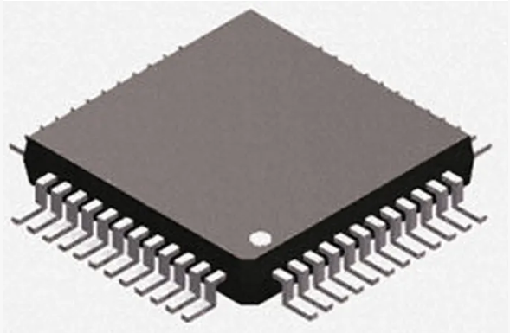
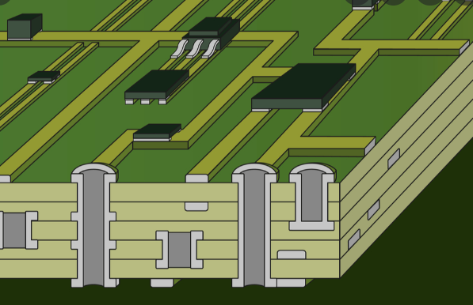
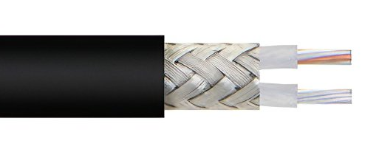
What is Signal Integrity?
Signal Integrity, or SI, is getting a Signal from one place to another with minimal signal distortion
This is achieved by minimizing Electrical Imperfections in the Channel
Tx
Rx
Cable
Chip Package
PCB
Connector

Slide 3


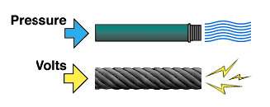


Pieces of Information
Signal’s Job is to Communicate Information between Two places
Electrical Voltage EM/RF Radiation
HELLO
HELLO

Slide 4
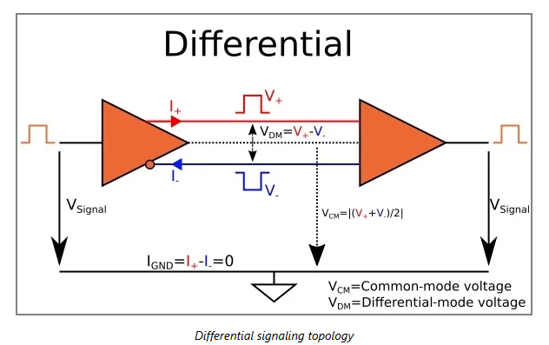
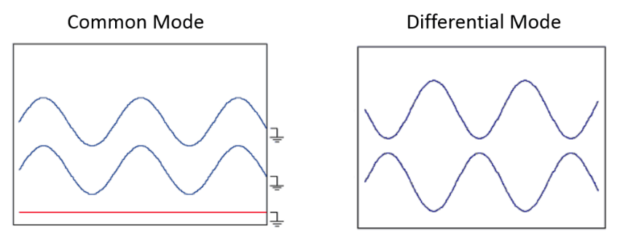
Differential vs. Common Signaling
V₊ V₊
V₋ V₋

Slide 5
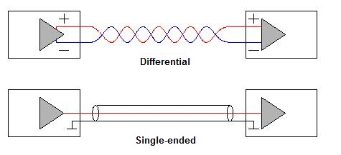
Single-Ended vs. Differential Signaling
Differential
Improved Noise Immunity = Lower Crosstalk
Requires 2 Conductors per Channel
Often used >5Gbps
Single-Ended
1 Conductors per Channel
Higher Crosstalk
I²C

Slide 6
Key Parameters
“S-parameters”
Input
Insertion Loss =
Transmitted
Mated
Connector
Input
Transmitted
Reflected
Return Loss =
Reflected
Input
Noise
Noise
Crosstalk=
Input
Example of a Sample/Device Being Tested

Slide 7
Insertion Loss / Throughput (SDD21)
Key Factors
Length of Connector
Insulator Materials
Conductor Materials
Conductor Sizes
Better Performance
Example Plot of a Device

Slide 8
Return Loss (SDD11/SDD22)
Key Factors
Differential Impedance (Z₀)
Mating Zone Design
Footprint Design
Example Plot of a Device
Better Performance
Mode Conversion Plot Profile and “Better Performance” Direction are the similar

Slide 9
Crosstalk—PowerSum NEXT/FEXT
Key Factors
Conductor Density/Spacing
Ground Structure
Shielding
Better Performance

